Slide 2






Software Engineer
Mentor @ SheCodeAfrica
Technical Writer @ Hashnode
IHEDIOHA CHINONSO
IHEDIOHA CHINONSO
@nonsodaniel07
@nonsodaniel
https://www.linkedin.com/in/chinonso-ihedioha-732665112/

Slide 3
Integrate Push Notifications in Your Web Application using Firebase
DEVFEST ILORIN 2019

Slide 4
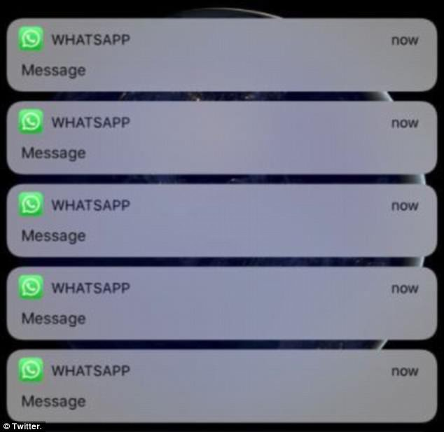
User Experirce for
NO

Slide 5
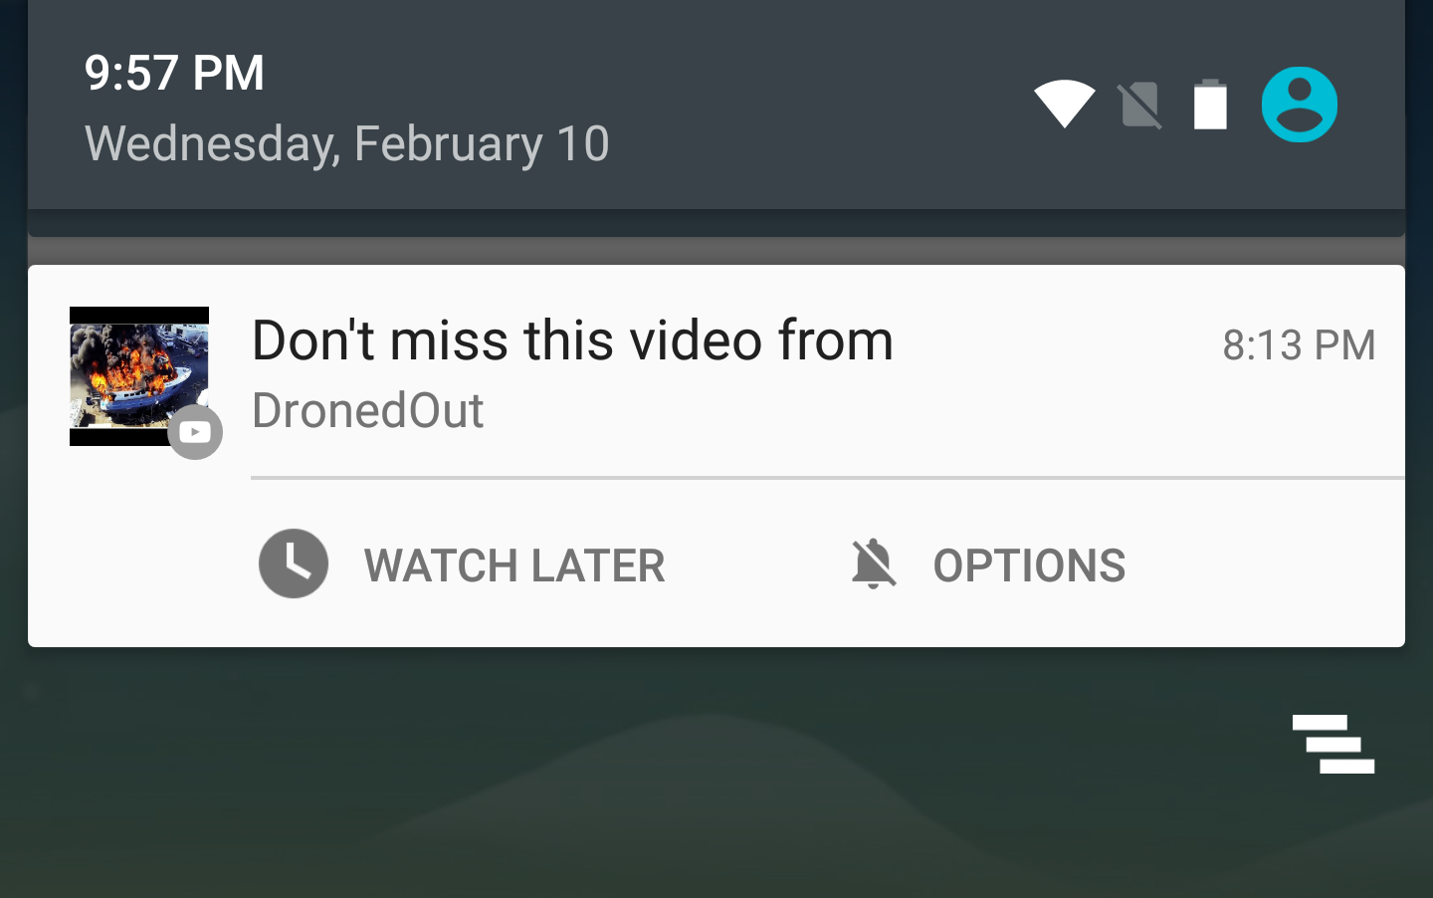
User Experirce for
NO

Slide 6
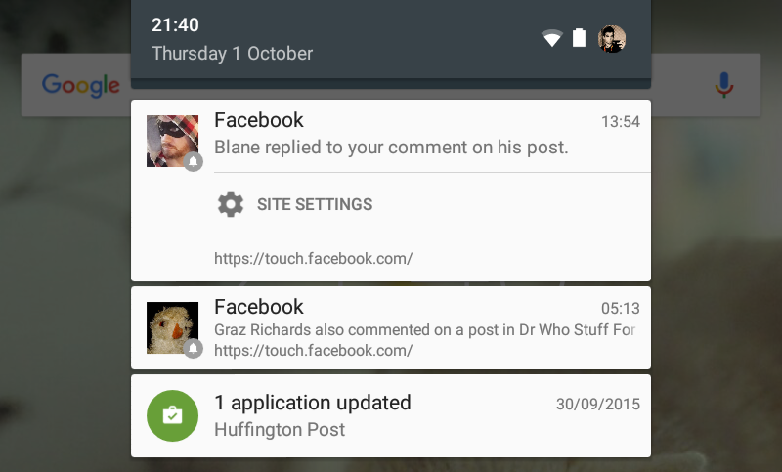
User Experirce for
NO

Slide 7
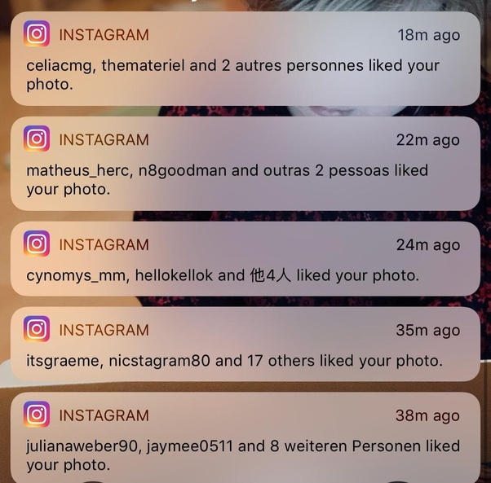
User Experirce for
NO

Slide 8
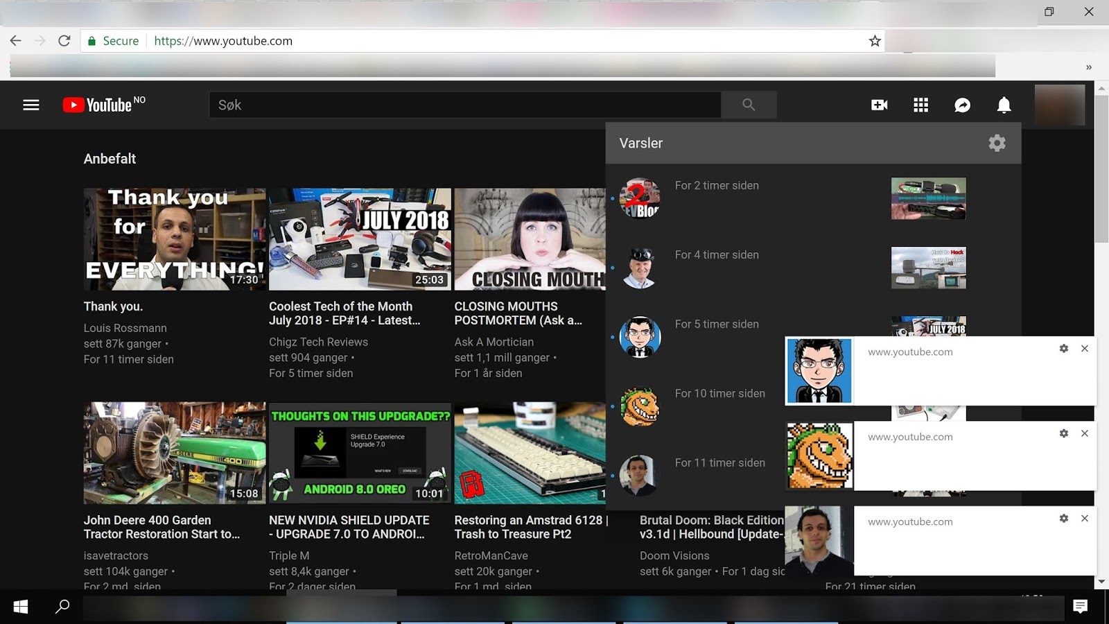
User Experirce for
NO

Slide 9
What are Push Notifications?
A notification is a message that pops up on the user's device. Notifications can be triggered locally by an open application, or they can be "pushed" from the server to the user even when the app is not running. They allow your users to opt-in to timely updates and allow you to effectively re-engage users with customized content.
Push Notifications are assembled using two APIs: the Notifications API and the Push API. The Notifications API lets the app display system notifications to the user. The Push API allows a service worker to handle Push Messages from a server, even while the app is not active.
The Notification and Push API's are built on top of the Service Worker API, which responds to push message events in the background and relays them to your application.

Slide 10
Terminologies used in Push Notifications
Notification – a message displayed to the user outside of the app's normal UI (i.e., the browser)
Push Message – a message sent from the server to the client
Push Notification – a notification created in response to a push message
Web Push – an informal term referring to the process or components involved in the process of pushing messages from a server to a client on the web
Push Service – a system for routing push messages from a server to a client. Each browser implements its own push service.
Web Push Protocol – describes how an application server or user agent interacts with a push service

Slide 11
Sending
and
Receiving Push Notifications

Slide 12
How it Works
1. The user subscribe to push messaging: the push service used by the browser returns data to enable you to send messages to the user.
2.Your app saves user data to your server.
3. Send a push message from your server to the user via the push service.
4. The user's app handles the push message in a service worker.

Slide 13
It is also good to know that:
Push notifications let your app extend beyond the browser, and are an incredibly powerful way to engage with the user. They can do simple things, such as alert the user to an important event, display an icon and a small piece of text that the user can then click to open up your site. You can also integrate action buttons in the notification so that the user can interact with your site or application without needing to go back to your web page.

Slide 14
Benefits of Push Notification
Help users meet their Goals
Get Insight on Customer Behavior
Nudge Users When They go Inactive
Remind Users To Complete an Action
Foster Engagement
A means of Improving your customer care strategy.

Slide 15
Disadvantages of Push Notification
Can be annoying if sent too frequently
Need to be sent in users time-zones (nobody likes being woken up at 4am by a push notification)
Decreases battery life on phones
Being optional – for brands they could be cut off from the customer
A means of Improving your customer care strategy.

Slide 16
A WISE MAN ONCE SAID:
“A great push notification is three things: timely, personal and actionable.” – Noah Weiss, Head of Search, Learning, & Intelligence at Slack

Slide 17
TIME TO CODE Visit https://github.com/nonsodaniel/push_notification/ Clone the repo and edit it to your own taste

Slide 18
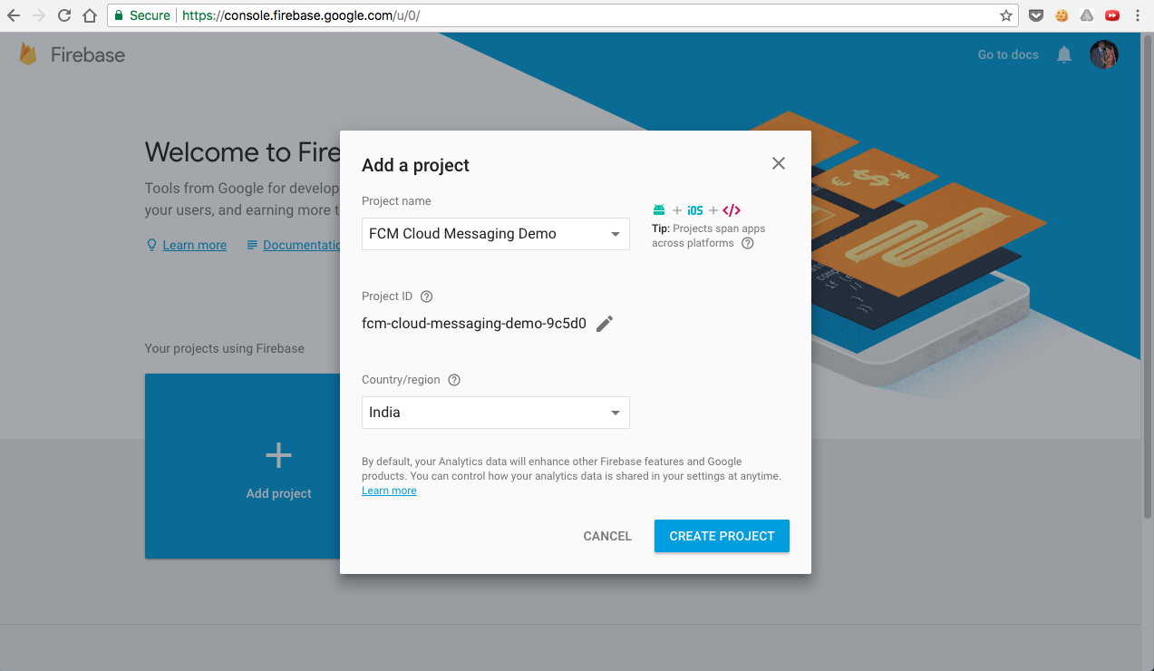

Slide 19
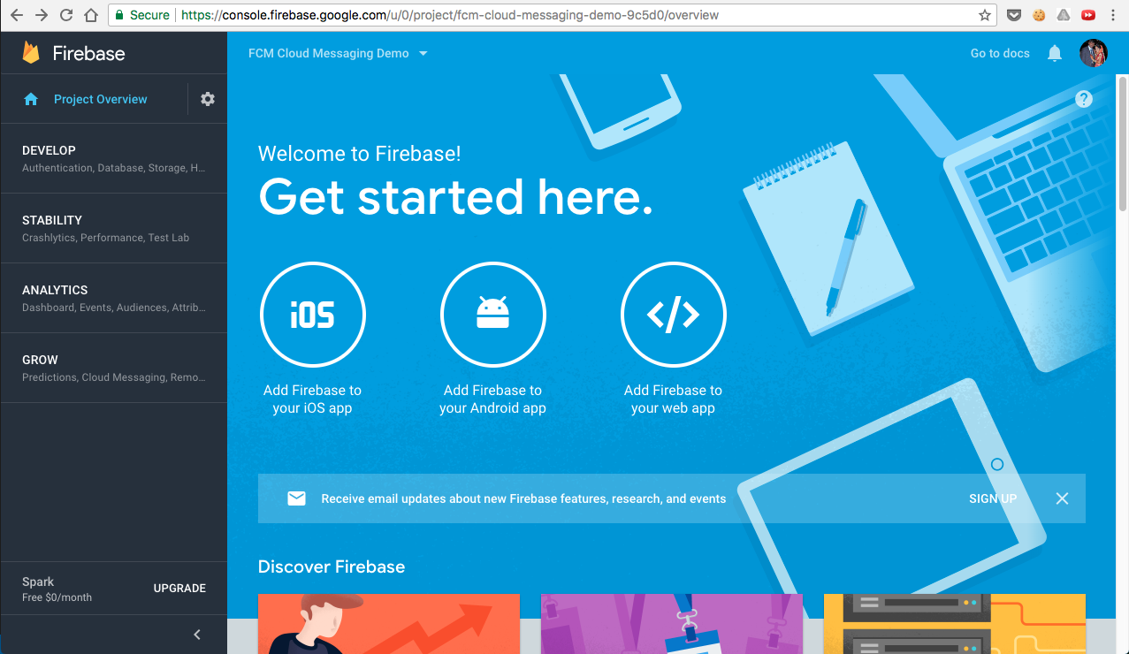

Slide 20
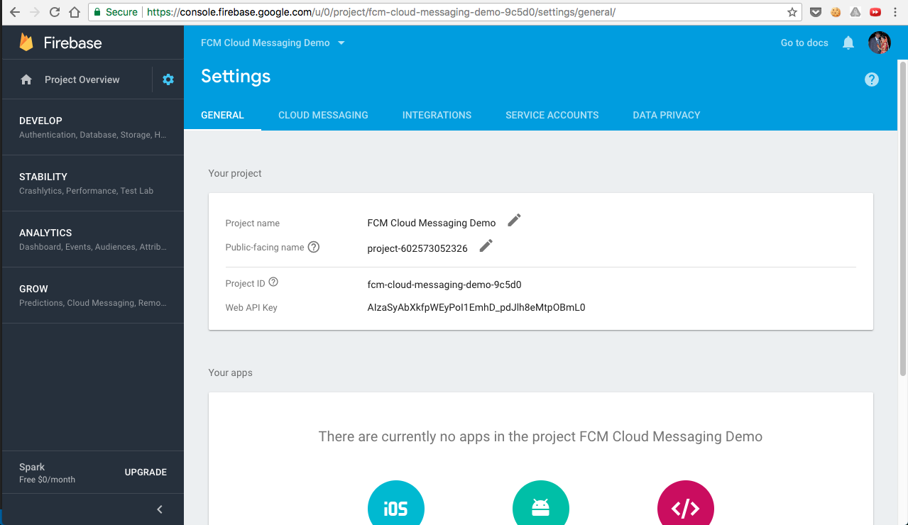

Slide 21
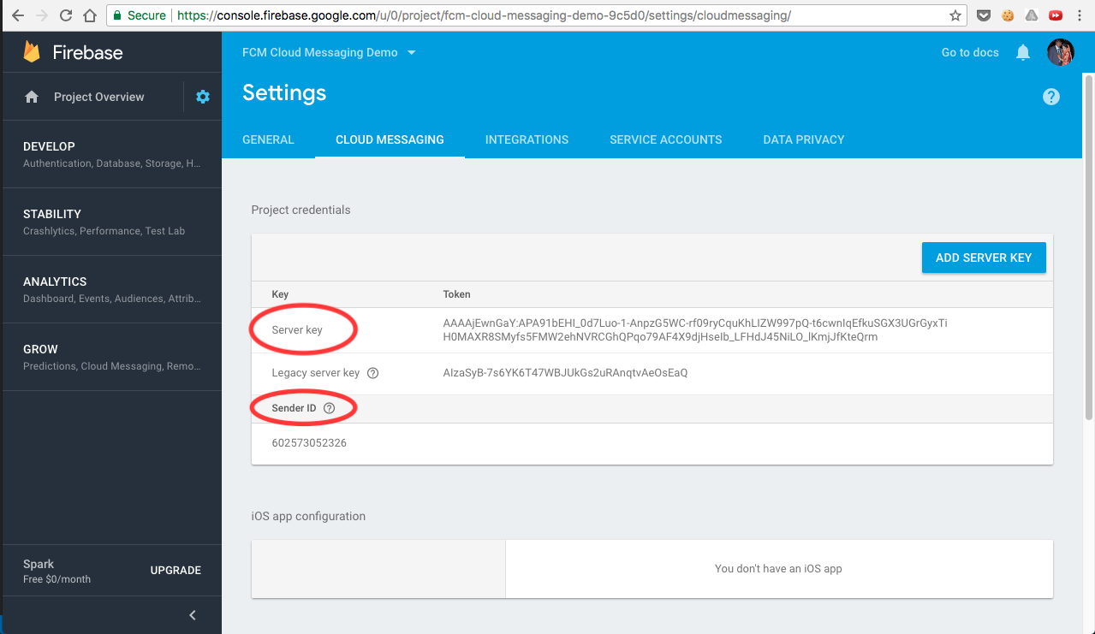

Slide 22
curl -X POST -H "Authorization: key=SERVER_KEY" -H "Content-Type: application/json" -d '{ "data": { "notification": { "title": "FCM Message", "body": "This is an FCM Message", "icon": "/ab-logo.png", } }, "to": "USER_TOKEN" }' https://fcm.googleapis.com/fcm/send

Slide 23
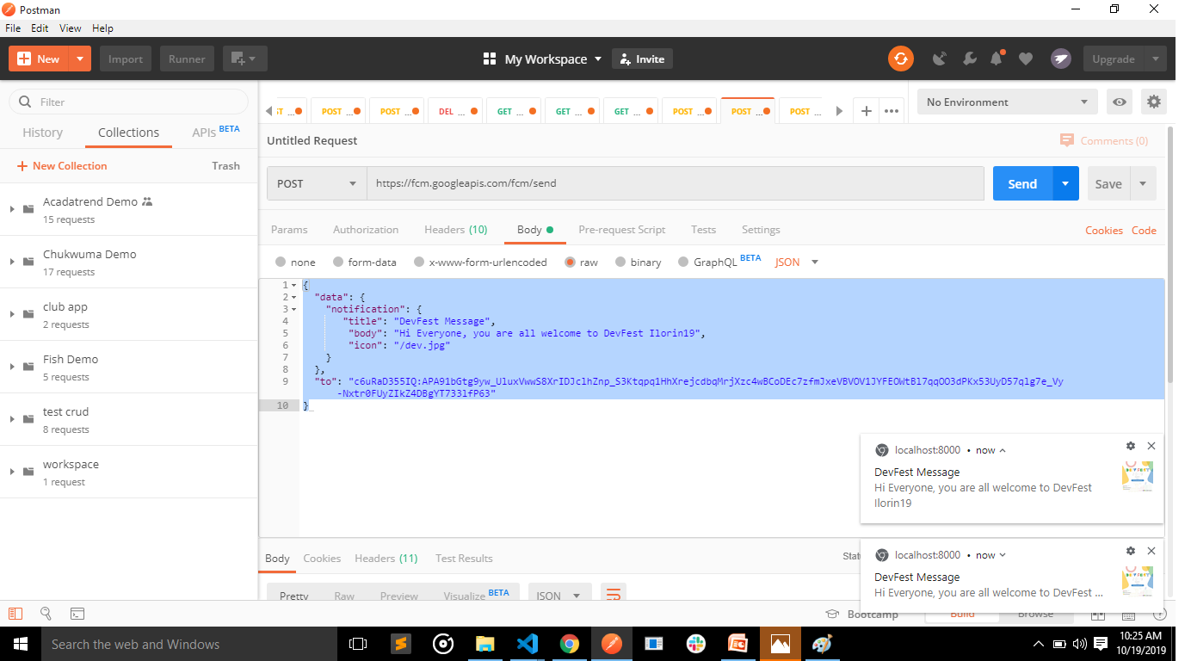

Slide 24
To learn more, kindly visit https://developers.google.com/web/ilt/pwa/introduction-to-push-notifications https://firebase.google.com/docs/cloud-messaging https://medium.com/@ashok.tankala/web-push-notifications-or-cloud-messaging-using-firebase-fcm-5a22ba559e58

